Slide 1


Slide 2
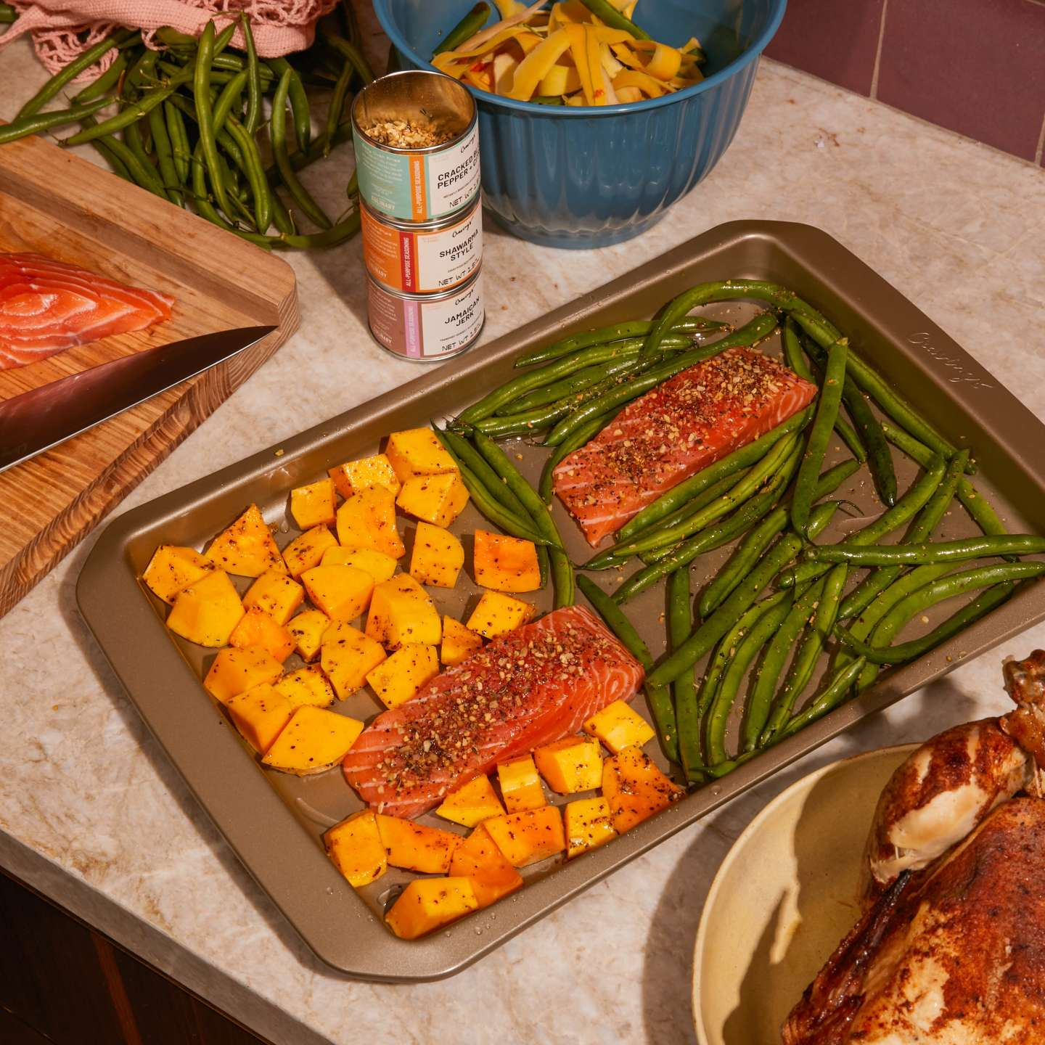
What's for dinner?
Not quite sure?
Trying to prepare meals for the week ahead?

Slide 3
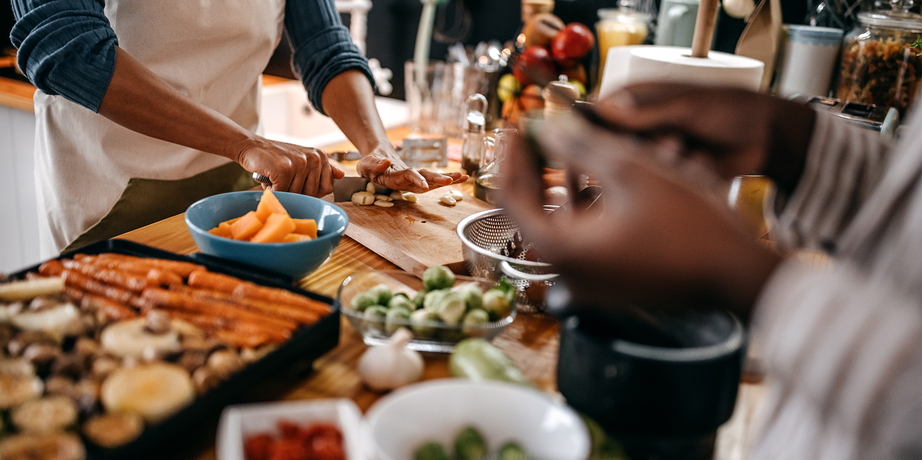
Let us help with that.
Search any meal you'd like to make and we'll lend a helping hand.
Multiple recipe suggestions with corresponding cooking instructions.
Nutrition breakdown of each meal along with serving sizes.

Slide 4
Description
We created an app that’s aimed at making meal prepping as easy as 1,2,3.
Built with JavaScript, HTML, CSS and a Bootstrap framework.
API used: Recipe
"https://api.api-ninjas.com/v1/recipe?query="
Nutrition Value
"https://api.api-ninjas.com/v1/nutrition?query="

Slide 5
Task Breakdown
Alisa : JavaScript code, HTML and CSS
Daisha: Styling, Bootstrap, ReadMe.
Victor: Styling, JavaScript and HTML
Shamary: JavaScript code, Styling and PowerPoint

Slide 6
The Pros and Cons

Slide 7
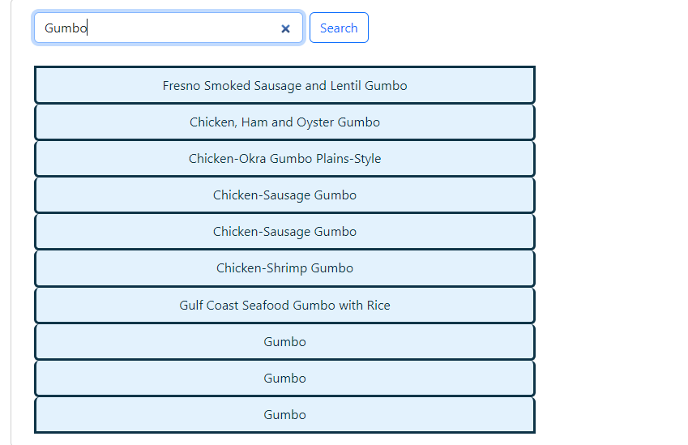
Project Demo -> Search the meal you'd like to make and get a great list of recipes.

Slide 8
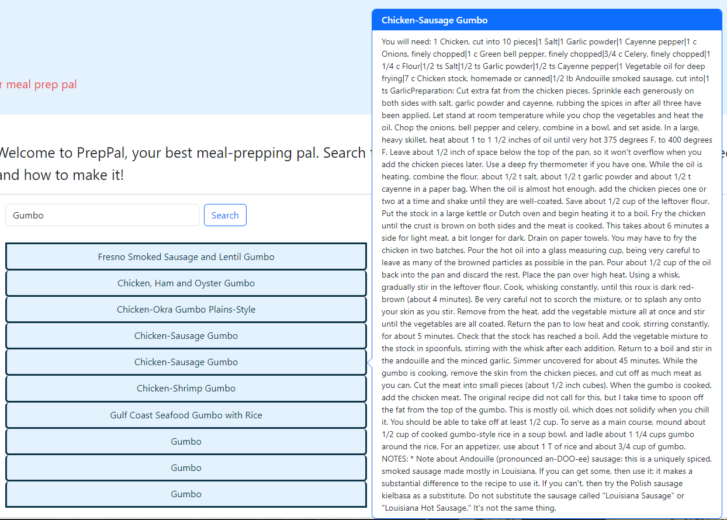
Click on chosen meal and the recipe and cooking instructions will pop up->

Slide 9
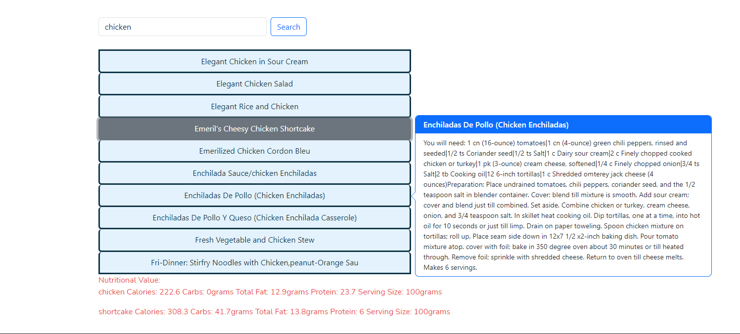

Slide 10
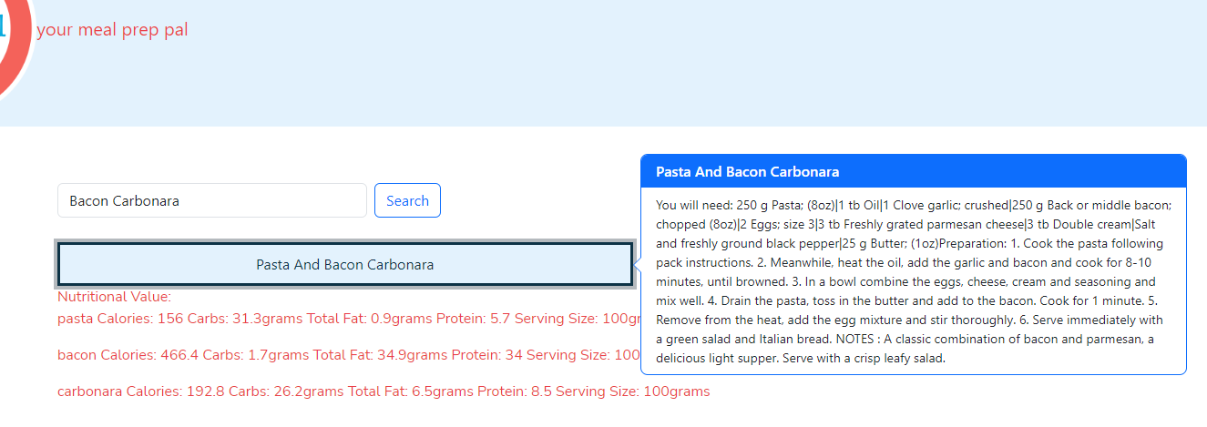

Slide 11
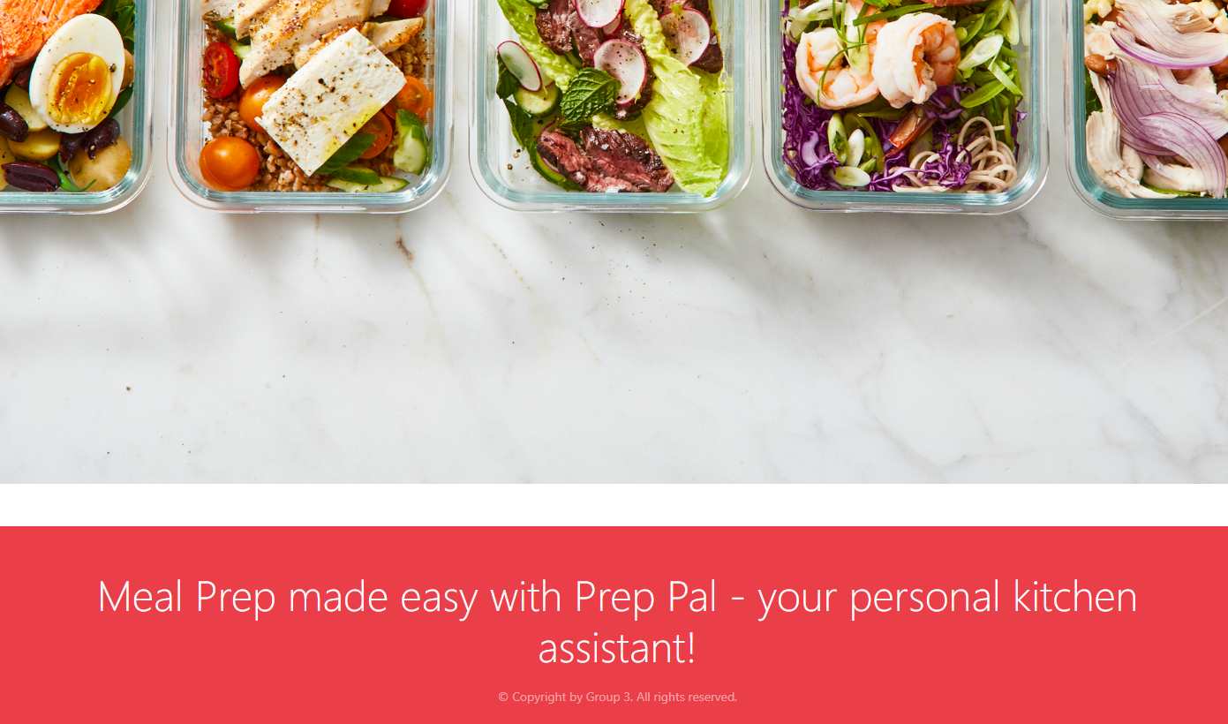

Slide 12
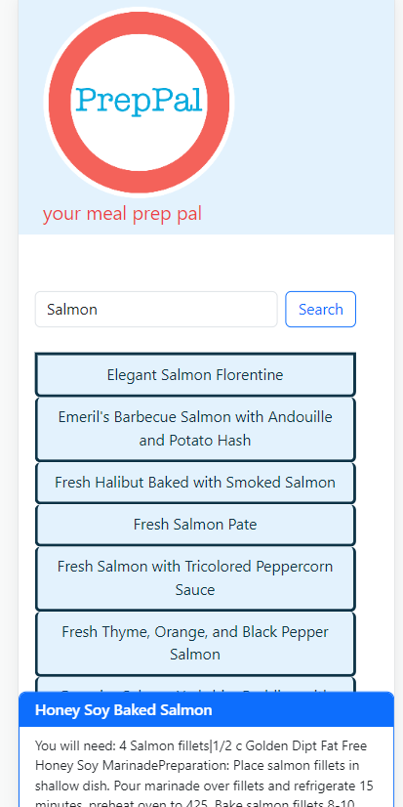
Mobile View->
Deployed Website: https://alisabevers.github.io/team-project-1/
Git Hub Repo: https://github.com/alisabevers/team-project-1

Slide 13
Future Features
Display images of recipes returned.
Clean up content in pop up so it can be more easily read.
Consolidate recipe and nutritional information into one pop up.
Add option for user to like meals to aid in recommendations as well as save their favourite recipes .

